Slide 1


Slide 2
Chapter 17
Synchronous Manufacturing and the Theory of Constraints

Slide 3
OBJECTIVES
Goldratt’s Rules
Goldratt’s Goal of the Firm
Performance Measurement
Capacity and Flow issues
Synchronous Manufacturing
Notes:
2

Slide 4
Goldratt’s Rules of Production Scheduling
Do not balance capacity balance the flow
The level utilization of a nonbottleneck resource is not determined by its own potential but by some other constraint in the system
Utilization and activation of a resource are not the same
An hour lost at a bottleneck is an hour lost for the entire system
An hour saved at a nonbottleneck is a mirage
Notes:
5

Slide 5
Goldratt’s Rules of Production Scheduling (Continued)
Bottlenecks govern both throughput and inventory in the system
Transfer batch may not and many times should not be equal to the process batch
A process batch should be variable both along its route and in time
Priorities can be set only by examining the system’s constraints and lead time is a derivative of the schedule
Notes:
5

Slide 6
Goldratt’s Theory of Constraints (TOC)
Identify the system constraints
Decide how to exploit the system constraints
Subordinate everything else to that decision
Elevate the system constraints
If, in the previous steps, the constraints have been broken, go back to Step 1, but do not let inertia become the system constraint
Notes:
5

Slide 7


Goldratt’s Goal of the Firm
The goal of a firm is to make money
Notes:
4

Slide 8
Performance Measurement:
Financial
Net profit
  an absolute measurement in dollars
Return on investment
  a relative measure based on investment
Cash flow
  a survival measurement
Notes:
5

Slide 9
Performance Measurement:
Operational
1. Throughput
  the rate at which money is generated by the system through sales
2. Inventory
  all the money that the system has invested in purchasing things it intends to sell
3. Operating expenses
  all the money that the system spends to turn inventory into throughput
Notes:
6

Slide 10
Productivity
Does not guarantee profitability
  Has throughput increased?
  Has inventory decreased?
  Have operational expenses decreased?
Notes:
7

Slide 11
Unbalanced Capacity
In earlier chapters, we discussed balancing assembly lines
  The goal was a constant cycle time across all stations
Synchronous manufacturing views constant workstation capacity as a bad decision
Notes:
8

Slide 12
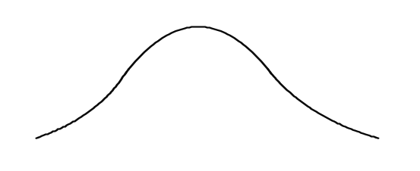
The Statistics of Dependent Events
(Variable)
(Constant)
When one process takes longer than the average, the time can not be made up
Process Time (A)
Process Time (B)
6 8 10 12 14
10
(Constant)
(Variable)
Process Time (B)
Process Time (A)
10
6 8 10 12 14
Rather than balancing capacities, the flow of product through the system should be balanced
Notes:
9

Slide 13
Capacity Related Terminology
Capacity is the available time for production
Bottleneck is what happens if capacity is less than demand placed on resource
Nonbottleneck is what happens when capacity is greater than demand placed on resource
Capacity-constrained resource (CCR) is a resource where the capacity is close to demand placed on the resource
Notes:
10

Slide 14
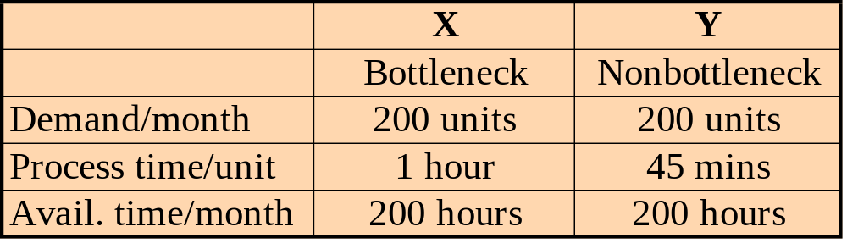
Capacity Example Situation 1
There is some idle production in this set up. How much?
Case A
25% in Y
X
Y
Market
Notes:
11

Slide 15
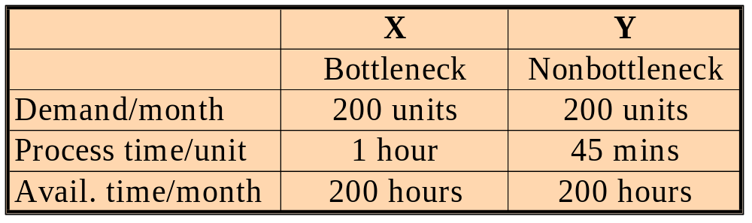
Capacity Example Situation 2
Is there is going to be a build up of unnecessary production in Y?
Case B
Yes, 25% in Y
Y
X
Market
Notes:
12

Slide 16

Capacity Example Situation 3
Case C
Is there going to be a build up in unnecessary production in Y?
Market
Yes, 25% in Y
Assembly
X
Y
Notes:
13

Slide 17
Capacity Example Situation 4
Yes, 25% in Y
If we run both X and Y for the same time, will we produce any unneeded production?
Case D
Market
Market
X
Y
Notes:
14

Slide 18
Time Components of Production Cycle
Setup time is the time that a part spends waiting for a resource to be set up to work on this same part
Process time is the time that the part is being processed
Queue time is the time that a part waits for a resource while the resource is busy with something else
Notes:
15

Slide 19
Time Components of Production Cycle (Continued)
Wait time is the time that a part waits not for a resource but for another part so that they can be assembled together
Idle time is the unused time that represents the cycle time less the sum of the setup time, processing time, queue time, and wait time
Notes:
16

Slide 20
Saving Time
What are the consequences of saving time at each process?
Bottleneck
Nonbottleneck
Rule: Bottlenecks govern both throughput and inventory in the system.
Rule: An hour lost at a bottleneck is an hour lost for the entire system.
Rule: An hour saved at a nonbottleneck is a mirage.
Notes:
17

Slide 21
Drum, Buffer, Rope
Exhibit 17.9
Bottleneck (Drum)
A
B
C
D
E
F
Market
Inventory
buffer
(time buffer)
Communication
(rope)
Notes:
18

Slide 22
Quality Implications
More tolerant than JIT systems
  Excess capacity throughout system
Except for the bottleneck
  Quality control needed before bottleneck
Notes:
19

Slide 23
Batch Sizes
What is the batch size?
One?
Infinity?
Notes:
20

Slide 24
Bottlenecks and CCRs:
Flow-Control Situations
A bottleneck
  (1) with no setup required when changing from one product to another
  (2) with setup times required to change from one product to another
A capacity constrained resource (CCR)
  (3) with no setup required to change from one product to another
  (4) with setup time required when changing from one product to another
Notes:
21

Slide 25
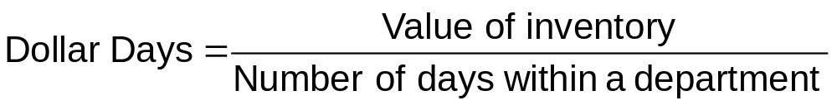
Inventory Cost Measurement:
Dollar Days
Dollar Days is a measurement of the value of inventory and the time it stays within an area
Notes:
22

Slide 26
Benefits from Dollar Day Measurement
Marketing
  Discourages holding large amounts of finished goods inventory
Purchasing
  Discourages placing large purchase orders that on the surface appear to take advantage of quantity discounts
Manufacturing
  Discourage large work in process and producing earlier than needed
Notes:
23

Slide 27
Comparing Synchronous Manufacturing to MRP
MRP uses backward scheduling
Synchronous manufacturing uses forward scheduling
Notes:
24

Slide 28
Comparing Synchronous Manufacturing to JIT
JIT is limited to repetitive manufacturing
JIT requires a stable production level
JIT does not allow very much flexibility in the products produced
Notes:
25

Slide 29
Comparing Synchronous Manufacturing to JIT (Continued)
JIT still requires work in process when used with kanban so that there is “something to pull”
Vendors need to be located nearby because the system depends on smaller, more frequent deliveries
Notes:
26

Slide 30
Relationship with Other Functional Areas
Accounting’s influence
Marketing and production
Notes:
27

Slide 31
End of Chapter 17

